Slide 1

Discrete Mathematics
And Graph Theory

Slide 2
1. Krushkal’s Algorithm
1.What is Krushkal’s Algorithm?
→ Kruskal's algorithm is the concept that is introduced in the graph theory of discrete mathematics. It is used to discover the shortest path between two points in a connected weighted graph.
2.How to Find MST(Minimum Spanning Tree) using Krushkal’s Algorithm?
→ Sort all the edges in non-decreasing order of their weight.
→ Pick the smallest edge. Check if it forms a cycle with the spanning tree formed so far. If the cycle is not formed, include this edge. Else, discard it.
→ Repeat step#2 until there are (V-1) edges in the spanning tree.
3.Spanning Tree- A spanning tree is the subgraph of an undirected connected graph.

Slide 3
To be continue……
4.Minimum Spanning Tree- Minimum spanning tree can be defined as the spanning tree in which the sum of the weights of the edge is minimum. The weight of the spanning tree is the sum of the weights given to the edges of the spanning tree.

Slide 4
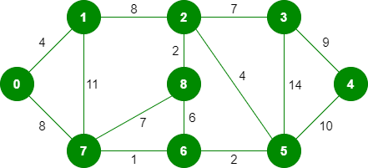
Kruskal’s Minimum Spanning Tree (MST) Algorithm
Note: Since the number of edges included in the MST equals to (V – 1), so the algorithm stops here
The graph contains 9 vertices and 14 edges. So, the minimum spanning tree formed will be having (9 – 1) = 8 edges.
Step 1: Pick edge 7-6. No cycle is formed, include it.
Step 2: Pick edge 8-2. No cycle is formed, include it.

Slide 5
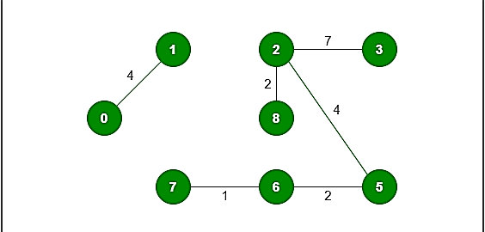

To Be Continue…..
Step 3: Pick edge 6-5. No cycle is formed, include it.
Step 4: Pick edge 0-1. No cycle is formed, include it.
Step 5: Pick edge 2-5. No cycle is formed, include it.
Step 6: Pick edge 8-6. Since including this edge results in the cycle, discard it. Pick edge 2-3: No cycle is formed, include it.
Step 7: Pick edge 7-8. Since including this edge results in the cycle, discard it. Pick edge 0-7. No cycle is formed, include it.

